Slide 1
MASTER THESIS Nr. 608 INTELLIGENT TRADING AGENT FOR POWER TRADING THROUGH WHOLESALE MARKET
Ivo Buljević
2012/2013

Slide 2
Contents
Introduction
Smart grid
Wholesale market
CrocodileAgent 2013
Conclusion

Slide 3
Introduction
Characteristics of the traditional energy market:
Centralized
Vertically integrated market structure
No competition
Liberalization and deregulation of the traditional energy market
Increased number of renewable energy sources
Progressive transformation of traditional power systems into evolved systems called smart grids

Slide 4
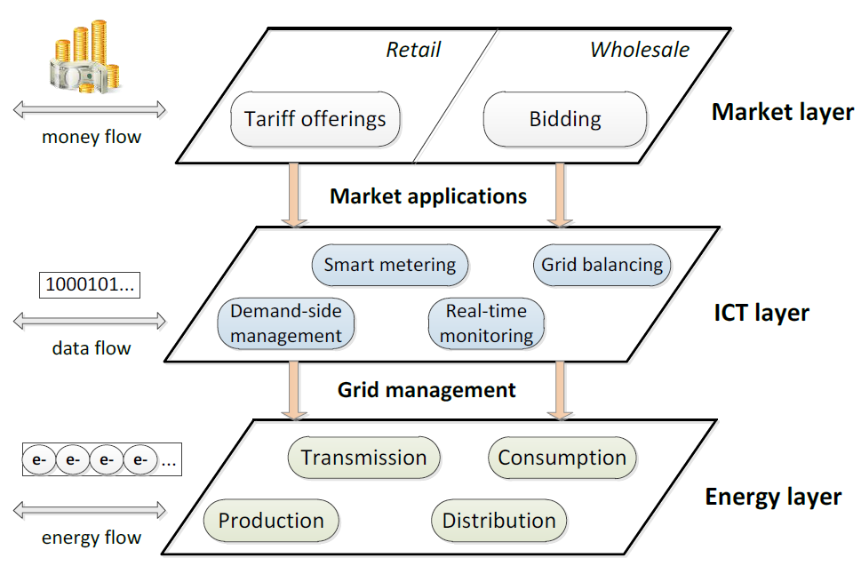
Smart grid
A modernization concept of the electricity delivery system
Enables real-time banacing of energy supply and demand
A two-way flow of electricity and information
Multi-agent market models
Entities are represented by intelligent software agents
Opportunity to test software solutions in order to prevent market crashes (California 2001)

Slide 5
Wholesale market
Result of liberalization and deregulation of the traditional energy market, enables energy trade between market entities
Power exchanges and power pools
Day-ahead market
Examples of wholesale markets:
Chile
Great Britain and Wales
Nord Pool
California

Slide 6
Wholesale market (2)
Energy load forecasting
Statistical approach
Similar-day method
Exponential smoothing
Regression methods
Artifficial intelligence – based tecniques
Reinforcement learning
Energy price forecasting
Spike preprocessing
Time series models with exogenous variables
Interval forecasts

Slide 7
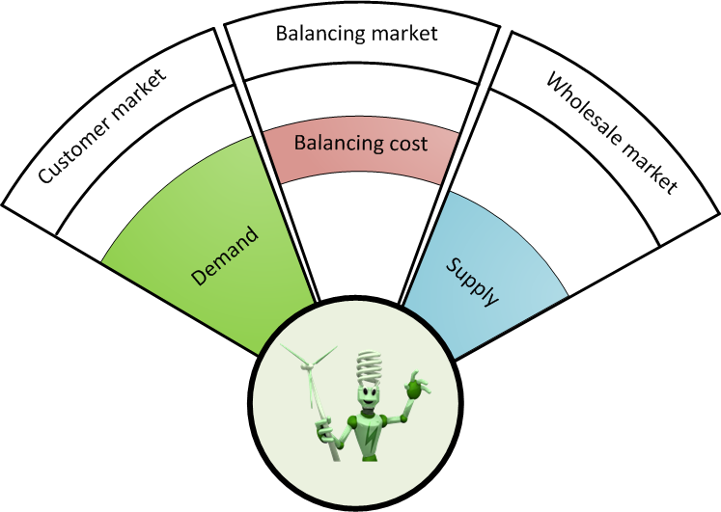
CrocodileAgent 2013
Intelligent software agent developed at University of Zagreb
Participant of PowerTAC 2013
Main emphasis:
Development of wholesale bidding strategy which will minimize negative effects on the balancing market
Responsive and context-aware agent design

Slide 8
CrocodileAgent 2013 Modular architecture
Contribution of
this master thesis

Slide 9
CrocodileAgent 2013 Learning module
Based on reinforcement learning
Erev-Roth method specially adapted for PowerTAC wholesale market
Enables broker to adapt to various market conditions
Key features:
Initialization
Choose strategy
Set rewards
Multiple strategies
Advanced strategy evaluation based on its efficiency
RL module
Simulator
Execute
Results

Slide 10
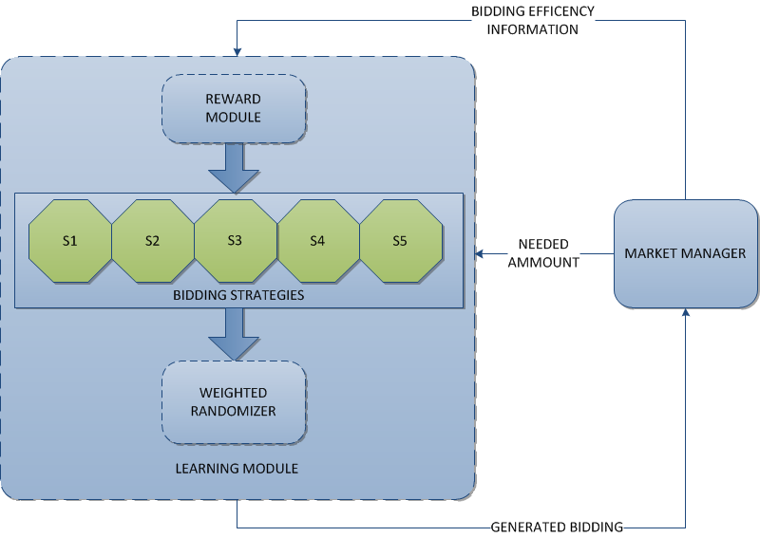
CrocodileAgent 2013 Learning module (2)
Uses basic order as an input
Generated by forecast module, based on past usage of subscribers on the retail market
Holt-Winters method
Life cycle:
Initialization
Choose strategy
Place order
Set reward
Strategies used to model amount of energy and unit price

Slide 11
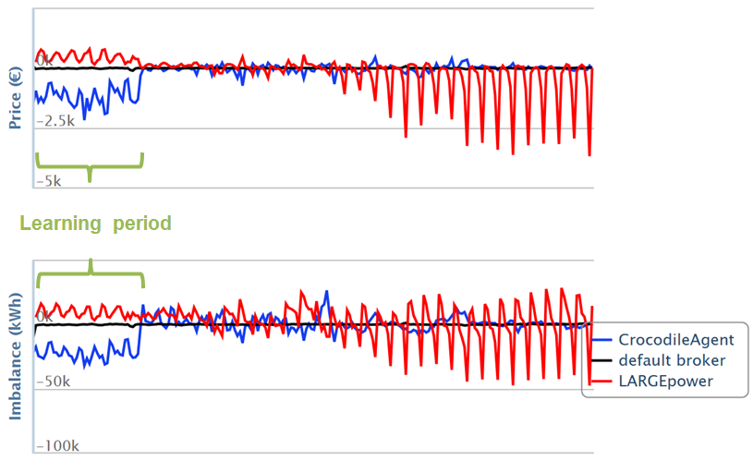
CrocodileAgent 2013 Results
Broker progressively learns to adapt to current market conditions – manifestation of the learning period
Minimization of balancing cost
Broker buys an excessive amount of energy on the wholesale market
Results from May trial indicates that broker buys 125% of energy needed on the retail market
A need to optimize basic order generation (energy load forecasting)

Slide 12
Conclusion
Robustness of the CrocodileAgent’s wholesale module
Broker is able to adapt to changes in competition environment
Adapted Erev-Roth algorithm was proved to be suitable for the PowerTAC wholesale market
Future work:
Improvement of energy load forecasting
Improvement in unit price calculation
Design of intelligent strategies

